Slide 1

CMR COLLEGE OF ENGINEERING & TECHNOLOGY
Kandlakoya, Medchal, Hyderabad - 501401
Department of Computer Science and Engineering
MedPredict CryptoPay
Batch No.:45
Name of the student:
B.MANI CHANDRA - 20H51A0506
B.SATHWIK-20H51A0559
K. SAI HARSHA - 20H51A05C7
Under esteemed guidance of
MS. BATHULA ARCHANA
Batch: 2020-2024 Major Project Phase 2

Slide 2
Outline
Abstract
Introduction
Literature survey
Existing system
- Problems in existing system
Research Objective of Presentation
Problem Definition
Research work
- Proposed system architecture
- Methods
- Comparison of Proposed system with an existing system
Performance Measure
Results
Conclusion
Future Work
References
Notes:
2

Slide 3
Abstract
Notes:
3

Slide 4
ABSTRACT
Med predict crypto pay is the system that is used to predict the diseases from the symptoms which are given by the patients. The system processes the symptoms provided by the user as input and it generates the probability of the disease. User can select specific doctor and can pay the fees by using crypto currency with blockchain .Medical prescription will be provided to the patient.

Slide 5
Introduction
Notes:
5

Slide 6
Introduction
This system uses machine learning algorithms to predict diseases from user-input symptoms.
It offers a unique feature, enabling patients to choose a doctor and make cryptocurrency payments.
The system shares disease probability with the chosen doctor, who then prescribes personalized medication.
This blend of technology and clinical expertise enhances diagnostic accuracy, offering patients tailored care based on disease predictions.
Notes:
6

Slide 7
Literature Review
Notes:
7

Slide 8
Comparison table for the existing system
S.No | Authors and Journal Name& Year of publication | Problem Statement | Name of the Proposed solution/Method | Solution | Remarks
1 | Rinkal Keniya, Vruddhi Shah et.al | 2020 | Inadequate access to timely and accurate medical diagnosis is a significant concern in healthcare, particularly for severe and diverse illnesses | Disease Prediction from Various Symptoms Using Machine Learning | This diagnosis model can act as a doctor for the early diagnosis of a disease to ensure the treatment can take place on time and lives can be saved. | This advanced disease prediction system, utilizing machine learning on 230+ diseases, attains 93.5% accuracy with weighted KNN. Its user-friendly interface ensures precise, timely disease diagnosis.
2 | Dhanashri Gujar et.al 2018 | Efficient analysis of patients' clinical records to predict disease likelihood and recommend specialists. | Disease Prediction based on symptoms and suggesting doctors for the predicted diseases. | Based on the predictions, the system suggests hospitals or clinics that align with the user's preferences, considering factors like location, cost, doctor experience, and reviews. | Based on the prediction, system recommends the hospitals and better reviews with doctors having expertise for that particular disease to avail the required medications

Slide 9
S.No | Authors and Journal Name& Year of publication | Problem Statement | Name of the Proposed solution/Method | Solution | Remarks
3 | Ramandeep Singh Sethi et.al | 2019 | Developing accurate and secure mobile healthcare applications is essential to meet the growing demand for digital healthcare services | Using Naïve Bayes algorithm | The model checks patients health background and takes symptoms as input and predicts disease. | This model gives probabilities of different diseases that can occur.
4 | Rahul Deo Sah1 et.al| 2017 | The challenge in medical diagnosis and clinical data analysis is selecting the most effective classification technique for disease prediction. | This model involves the use of a "K-nearest neighbor (KNN) classifier. | It is a straightforward and effective method for predicting medical diseases based on symptom data, making it a valuable tool in data mining for healthcare applications. | KNN's performance may vary depending on the choice of 'k' and the quality of the training data, making parameter tuning and data preprocessing crucial for optimal results.
5 | Venkatesh Rallapalli et.al 2022 | A web-based doctor appointment system which allows doctors and patients to register, schedule appointments. | The method used for implementing the Online Doctor Appointment Website is the "Waterfall Model. | Doctors can register, manage appointments, and provide prescriptions, while patients can register, book appointments. | The division of roles and responsibilities is effective in streamlining the appointment process.

Slide 10
Implementation of Existing System
The system employs machine learning to predict diseases based on symptoms and patient data.
Predictive algorithms to suggest doctors based on user symptoms.
The system provides an integrated solution for patients seeking both diagnosis and specialist recommendations using the Weighted KNN algorithm to predict diseases.
The output includes probabilities for different possible diseases.
By analyzing user-input symptoms,it predicts diseases. Moreover, it suggests hospitals or clinics based on user preferences, considering proximity, cost, doctor expertise, and reviews. Users can offer feedback on recommended doctors, enhancing the system's overall quality and ensuring patients receive the necessary medical care efficiently.

Slide 11
Research Objective
Notes:
11

Slide 12
Research objective
It is to develop an machine learning with medical expertise and utilizes blockchain technology for secure payment transactions. Specifically, the primary research objectives include:
Machine Learning Model Development: Develop and refine machine learning models that can accurately predict diseases from patient-reported symptoms, encompassing textual descriptions.
Secure Payments: Integrating blockchain and cryptocurrency technology to provide patients with a secure and transparent method of paying for medical service.
Cryptocurrency Integration: Explore the integration of various cryptocurrencies and blockchain technologies into the system, ensuring a seamless and user-friendly payment process for patients and healthcare providers.

Slide 13
Problem Definition
Notes:
13

Slide 14
Problem Definition
In contemporary healthcare, there is a need to enhance disease diagnosis and medical consultation processes.
Many patients seek accurate and timely disease predictions, while healthcare providers require secure and transparent payment methods for their services.
"Med Predict Crypto Pay" aims to address these needs by offering a system that predicts diseases from patient symptoms, enables cryptocurrency-based payments, and fosters a collaborative approach to medical prescription. To securely pay the fee and to get prescription for the symptoms.

Slide 15
Research Work
Notes:
15

Slide 16
Patient Module
Block Diagram

Slide 17




Pateint Authentication
New user
Existing user
Register
Enter user id
And
password
give
symptoms
Train
model
Patient
details
database
Dataset Machine
Learning
Doctor
Chart Box
Suggested
doctors
Consult
doctors
If Payment is done
Select
doctor
Payment of Consultation FEE (using Cryptocurrency)

Slide 18
Doctor Module
Block Diagram

Slide 19

Doctor Authentication
New user
Existing user
Register
Enter doctor id
And
password
View patients
doctor
details
database
If Payment is done
select patient
See symptoms and
Predicted
disease
Chart Box

Slide 20
Admin Module
Block Diagram

Slide 21
Register
New user
Patient
details
database
Patient
Existing user
give
symptoms
Dataset Machine
Learning
View
and
Delete
Enter user id
And
password
Trained
model
Admin
View patients
Doctor
Suggested
doctors
Consult
doctors
Doctors
If Payment is done
Select
doctor
New Doctor
Existing Doctor
Register
Enter doctor id
And
password
Chart Box
select patient
See symptoms and
Predicted
disease
Payment of Consultation FEE (using Cryptocurrency)
Doctor details
database

Slide 22
PROPOSED METHOD
Med predict crypto pay is the system that is used to predict the diseases from the symptoms which are given by the patients.
The system processes the symptoms provided by the user as input and it generates the probability of the disease.
User can select specific doctor and can pay the fees by using crypto currency with blockchain, and the patient and doctor can chat by using chat box .

Slide 23
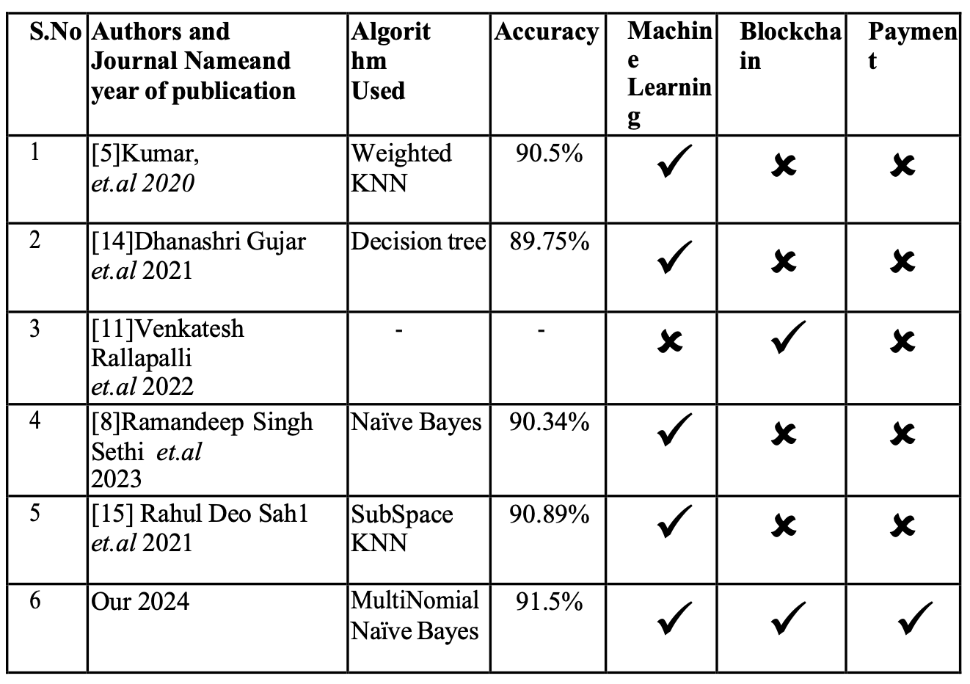
Performance Measure:

Slide 24
Result
Innovative Disease Prediction: Med Predict Crypto Pay revolutionizes healthcare by employing machine learning to predict diseases based on patient symptoms, enhancing diagnostic accuracy and early detection.
Secure Cryptocurrency Transactions: Integrating blockchain technology, the system enables secure cryptocurrency payments, ensuring efficient financial transactions while maintaining user privacy and data integrity.
Personalized Healthcare Experience: Users can select specific doctors, fostering a personalized healthcare journey. Doctors receive detailed symptom data, allowing for tailored medical prescriptions and accurate diagnoses.’
Collaborative Diagnostic Approach: The system combines machine learning predictions with doctors' expertise, fostering collaboration. Doctors analyze data alongside clinical insights, leading to well-informed decisions and customized treatment plans.
Global Accessibility and Inclusivity: With borderless cryptocurrency payments, the system promotes global healthcare accessibility, ensuring individuals worldwide can access quality medical services, promoting inclusivity and equality in healthcare.

Slide 25
Conclusion
Our system, Med Predict Crypto Pay, is a groundbreaking advancement in disease prediction. It uses advanced machine learning to minimize reliance on human expertise, reducing misdiagnosis risks and enabling timely health issue identification. With blockchain-powered secure payments, patients can easily handle transactions, while doctors gain precise disease predictions for prompt treatment. This innovative tech fusion transforms diagnostics and creates a globally accessible healthcare platform, emphasizing early detection and personalized care.

Slide 26
Future work
1. Enhanced Disease Prediction Models:
Broaden coverage and accuracy through advanced machine learning algorithms.
Incorporate diverse datasets and genetic/biomarker data for precision.
2. Integration of Emerging Technologies:
Utilize AI with IoT devices and wearables for real-time health monitoring.
Explore immersive healthcare experiences with AR/VR technologies.
3. Continuous Improvement of Blockchain Payment System:
Strengthen security protocols for data privacy and compliance.
Streamline transactions and reduce fees for widespread adoption.
4. Collaborative Research and Development:
Forge partnerships with healthcare institutions and technology companies.
Conduct clinical validation studies for predictive models.

Slide 27
References
Kumar, A., Bharti, R., Gupta, D. and Saha, A.K., "Improvement in boosting method by using rustboost technique for class imbalanced data", in Recent Developments in Machine Learning and Data Analytics: IC3 2018, Springer., (2019), 51-66.
Stitt, F.W., 1993. The Problem-Oriented Medical Synopsis: a patient-centered clinical information system. In Proceedings of the Annual Symposium on Computer Application in Medical Care (p. 88). American Medical Informatics Association.
Akinode, J.L. and Oloruntoba, S.A., 2017. Design and implementation of a patient appointment and scheduling system. Department of Computer Science, Federal Polytechnic Ilaro Nigeria.

Slide 28
Thank You!

